Slide 1

ICW – Automation Approach
LTI - IPAT Framework

Slide 2
Agenda
IPAT Automation Framework introduction.
ICW - Test Automation Process.
Benefits of IPAT.
IPAT Vs Other Automation Frameworks.
Presentation of IPAT Architecture with Application Under Test.
Test Execution Report and Recordings.
Questions & Answers.

Slide 3
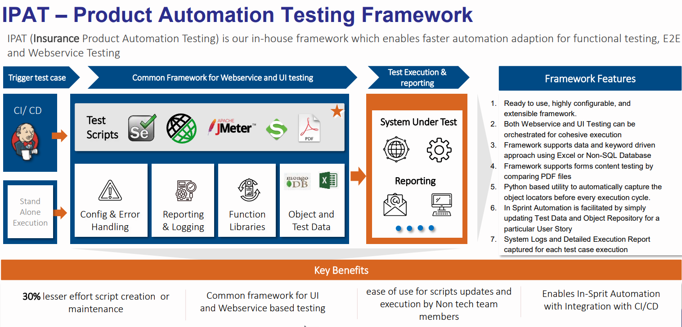

Slide 4
ICW - Test Automation Process Driving efficiency & coverage with a special focus on ICW functional automation Testing needs
Objectives
Support smoke, functional, regression, cross browser and service testing across business functionalities
Promote faster builds, continuous integrations, shorter deployment cycles
Increased coverage across Core Business areas
Increased consistency of testing leveraging Automation for manual intensive test cases
Approach
Leverage LTI’ s reusable automation framework to build a Robust Automation Framework based on Selenium/TestNG framework
Early Automation approach to minimize Risks related to potential gaps
Automated Smoke testing and environmental availability testing
Leverage automation Scripts for Development and UAT Phases as appropriate (eg – Automated Unit testing framework)
Scriptless Automation for effective functional testing, modular tests and browser compatibility tests
Trigger lab deployment and integrate the framework
Integrate Automated scripts with continuous integration (Jenkins etc.) pipeline and automate reporting to ICW stakeholders
Focus on coverage across key business areas enhancing the team to accelerate the testing during SIT phase
Expected deliverables/outcomes
Accelerators
Reusable and scalable automation framework with substantial functional coverage across key business areas
Reusable automation scripts for different areas of the application landscape
PDF compare tool

Slide 5
Benefits
Overall Benefits
Works across all the P&C insurance platforms
Support Agile development
Increase Automation
Supports progression testing of new features is possible
Enable Manual/Functional testers to do test automation
Save Testing Effort
Reduce effort across testing lifecycle, test design and execution by optimizing the test cases
Faster script development
Shorten Time To Market
Start automation activity early
Write manual test cases that automate easily
Support Functional and Regression Automation
Support Web and API testing
Support Cross Browser testing
40-50% effort reduction in script development saves the project overall timelines with maximum automation coverage
20-25% effort reduction in test design phase
Anyone can automate
Flexible execution reports with screen recording feature
No Synchronization issues as the framework handles it automatically
Less execution time comparing to other frameworks
Faster execution
Flexible report feature
Do test automation at faster pace
Automatically captured the object locators
Static forms testing is easy

Slide 6



IPAT Vs Other Automation Frameworks
Day 0
Day 10
Day 30
60 Days
Test Planning
Regular
Automation
Test Design
Manual test preparation
Test Execution
Automation development
Test Closure
Test Planning
Test Design
Manual test preparation
Test Execution
Automation using
IPAT
Automation development
Test Closure
Progression + Regression automation
Reduced automation effort using a Lean automation team
Effort Reduction
30-35% in Test Design
35-40% in Auto Dev
Cycle Time Reduction
15% in Test Cycle Time

Slide 7
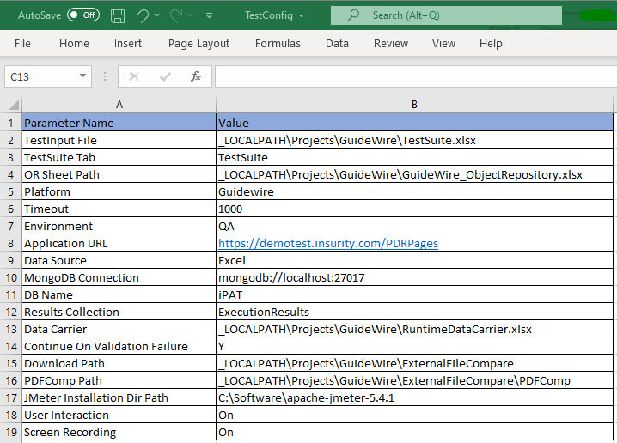
Architecture of IPAT automation framework - Workflow
Configuration Setup
Location of Test input file
Location of Object Repository file
Environment and Application URL
Data source and MongoDB connection
Data carrier / Download paths
User Interaction / Screen Recording

Slide 8
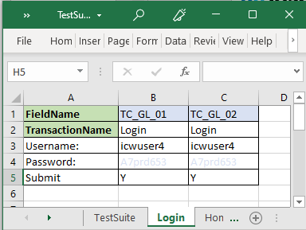
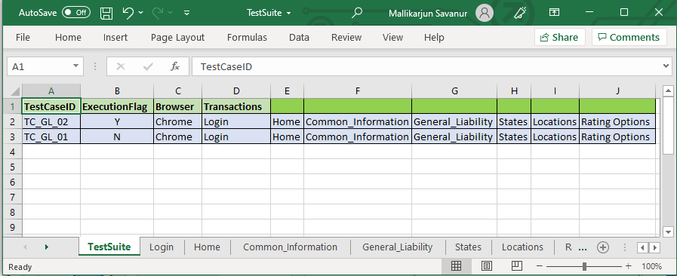
Architecture of IPAT automation framework - Workflow
Test Suite and Test Cases
TestSuite consist all the Test cases
Other sheets will be with test steps (Page wise)

Slide 9
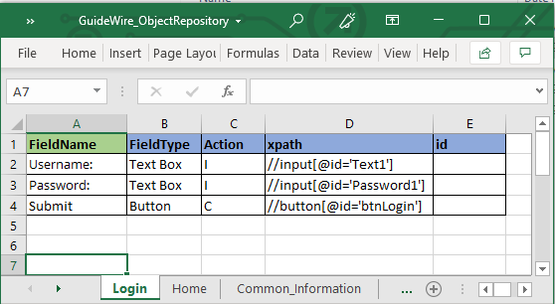
Architecture of IPAT automation framework - Workflow
Object Repository (OR)
Login Object Repository

Slide 10
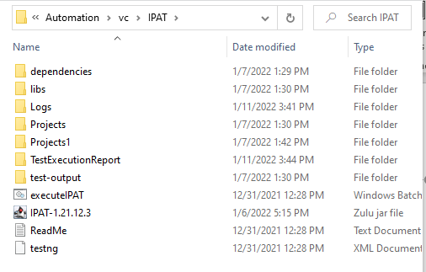
Architecture of IPAT automation framework - Workflow
File / Folder Structure
Dependencies and Libraries
Logs and Test Execution Report
Execute Batch file

Slide 11
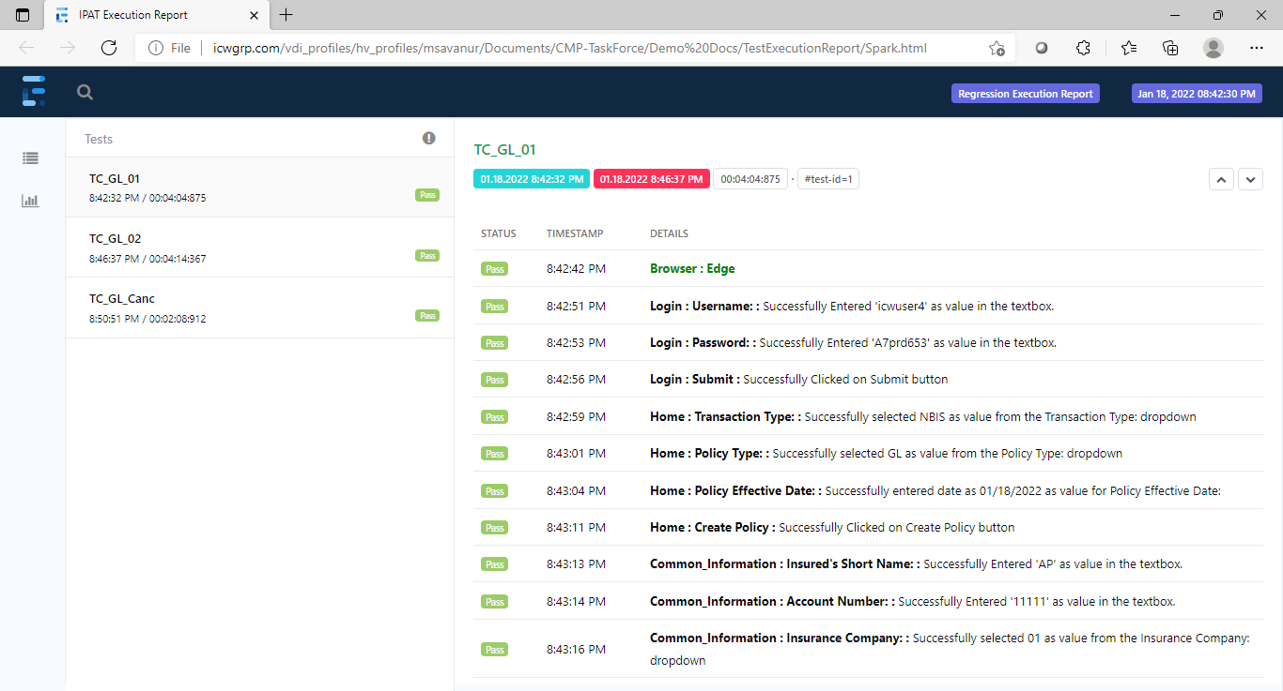
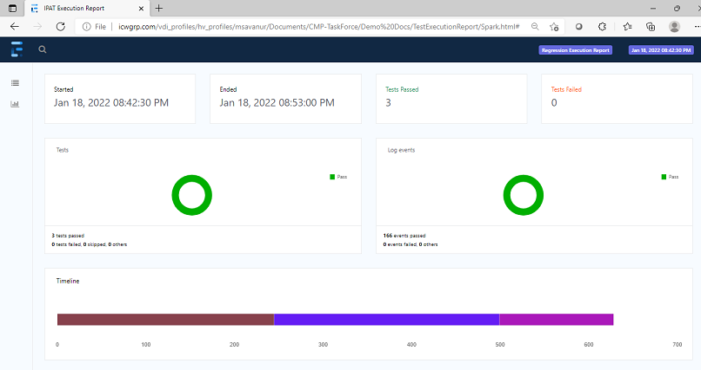
Test Execution Report
Extent Report

Slide 12
ICW – Automation Approach
LTI - IPAT Framework
Questions and Answers

Slide 13
Thank you

